Slide 1
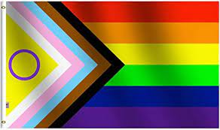
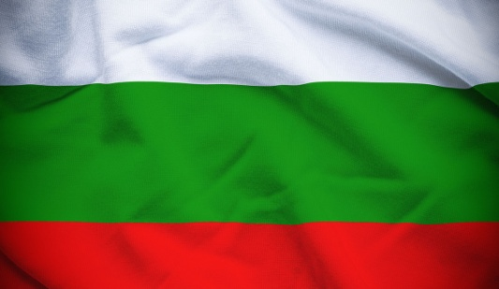
Being LGBTQAI+ IN BULGARIA

Slide 2
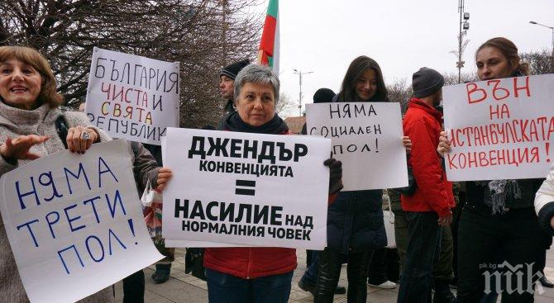
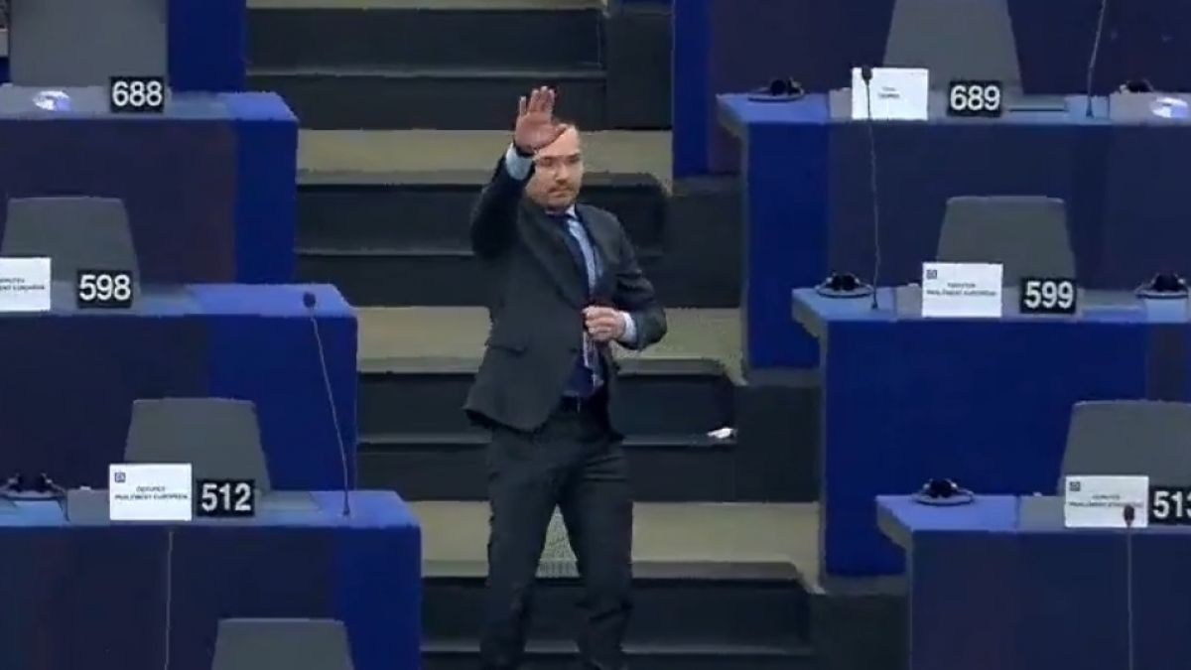
Political situation
Law restrictions and discrimination
Definition of marriage
Donation and adoption
Is “Hate Crime” punishable?
Trans Rights
Gender Identity and the word “gender”
The Istanbul Convention
Party representation
Low level of political engagement
Right-winged parties

Slide 3
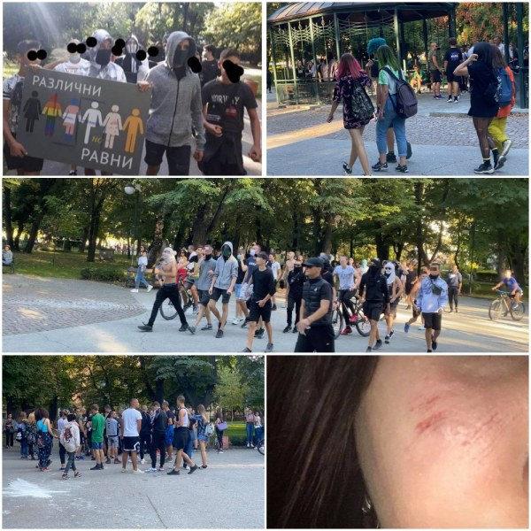
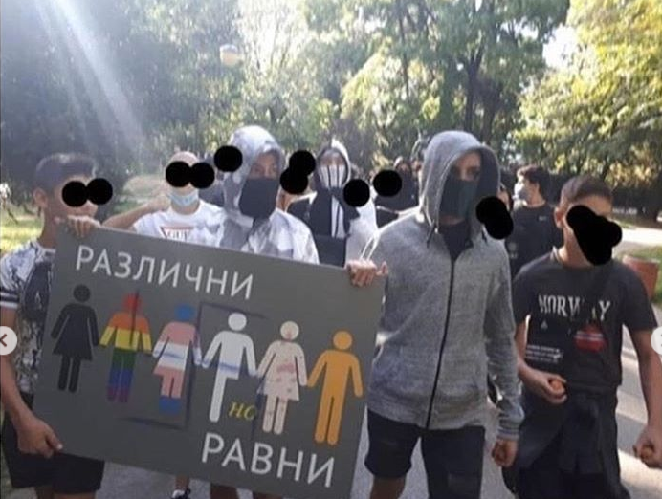
Social situation
Constant danger for looking “gay”
Physical violence and tragic endings. Especially among children.
The attack on Rainbow Hub
Hidden and internalized homophobia
Safe spaces and community centers

Slide 4
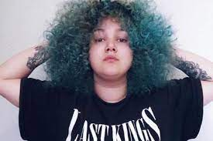
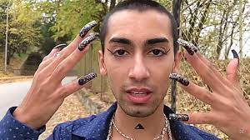
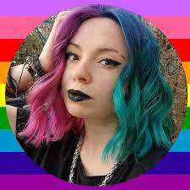
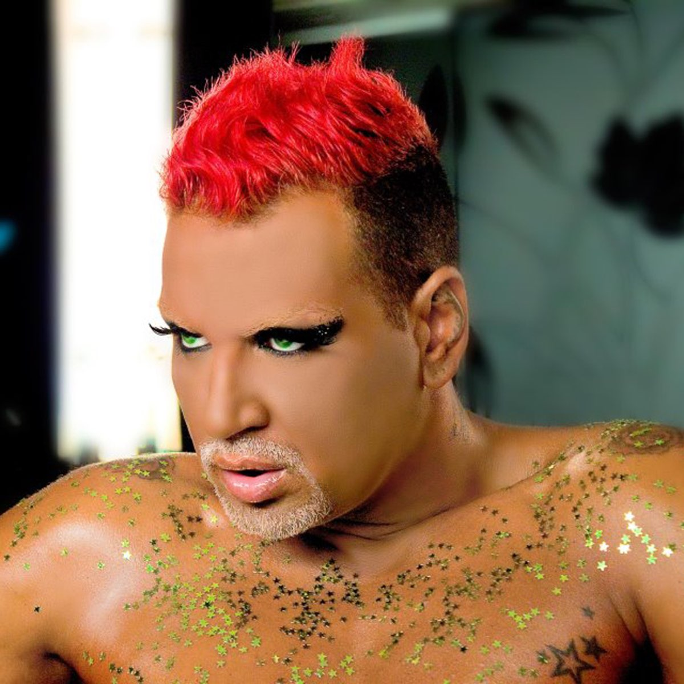
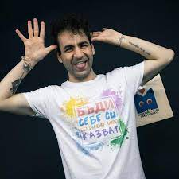
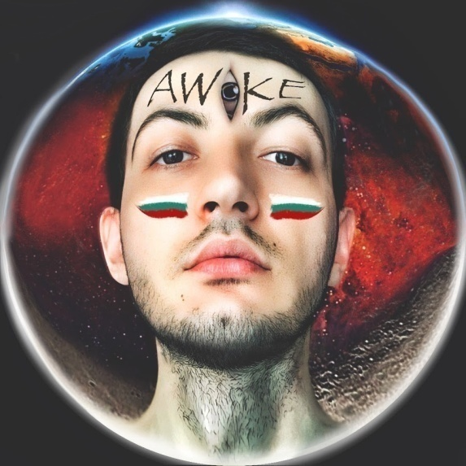
Online and media representation and activism

Slide 5
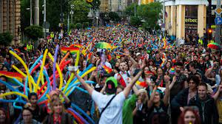
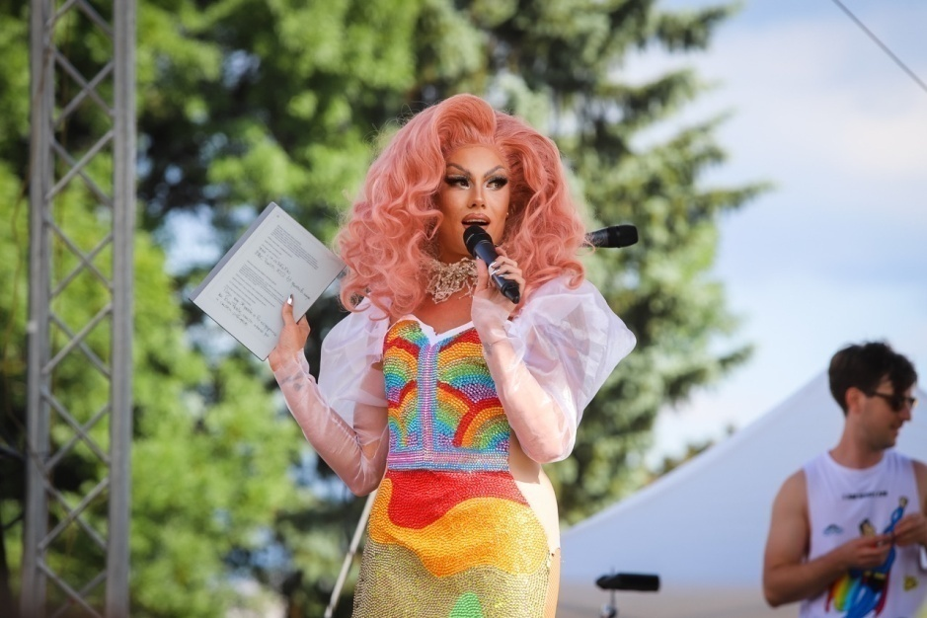
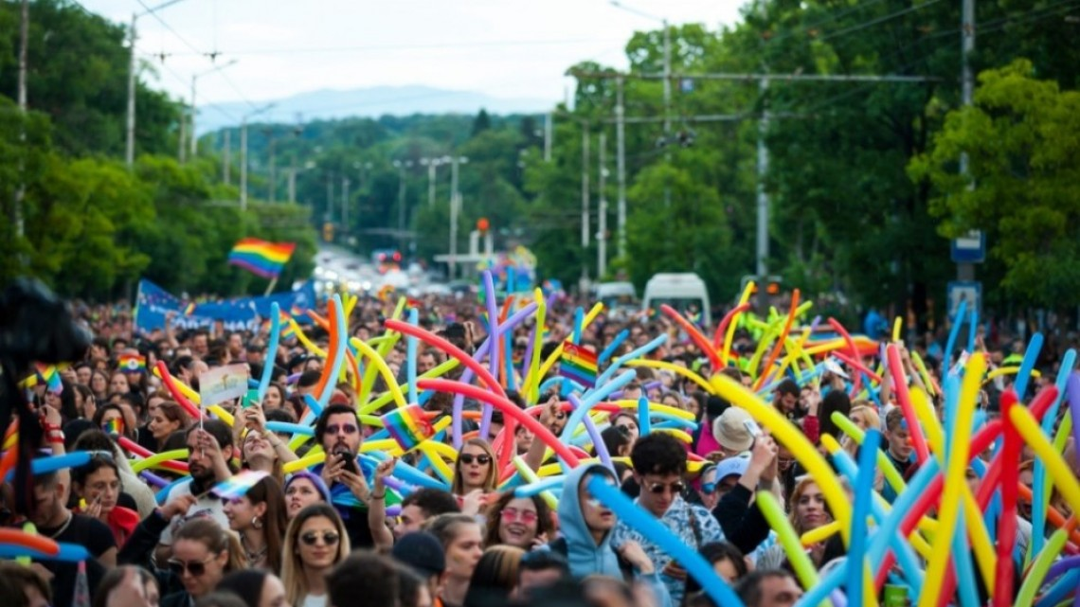
Pride
Sofia Pride- 12 000 people
Celebrities and support

Slide 6
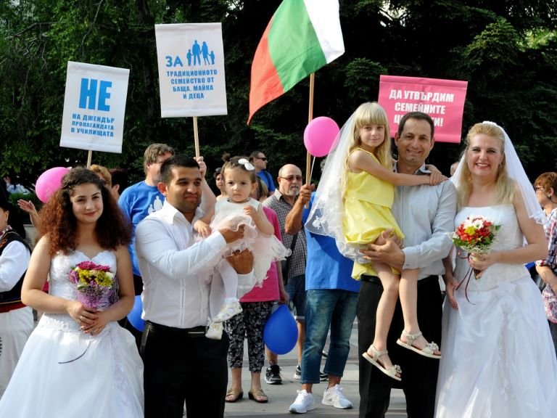
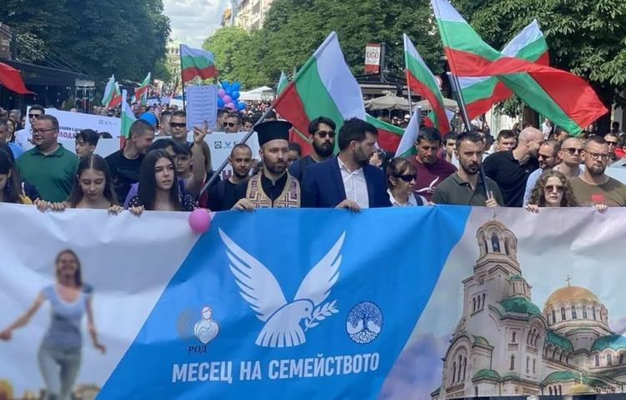
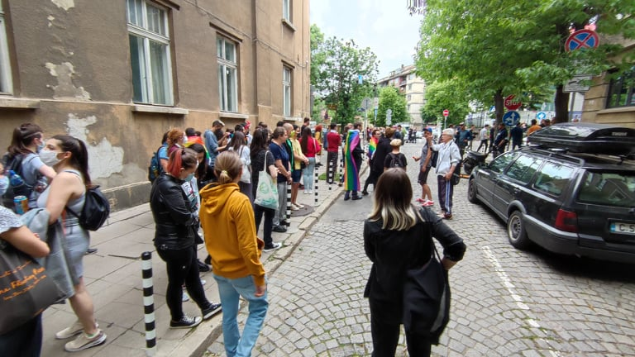
Pride
The attacks and sabotages
Increased violence
Counter-Pride
Burgas Pride 2021

Slide 7
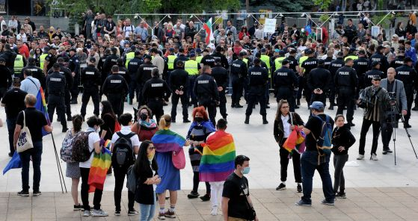
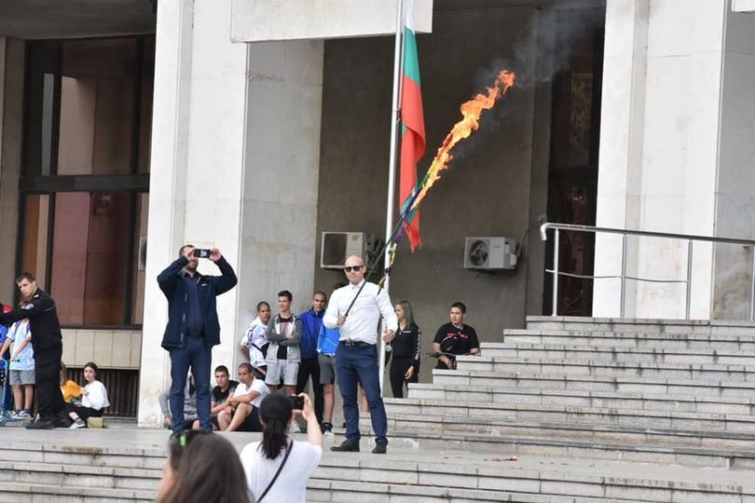
Burgas Pride

Slide 8
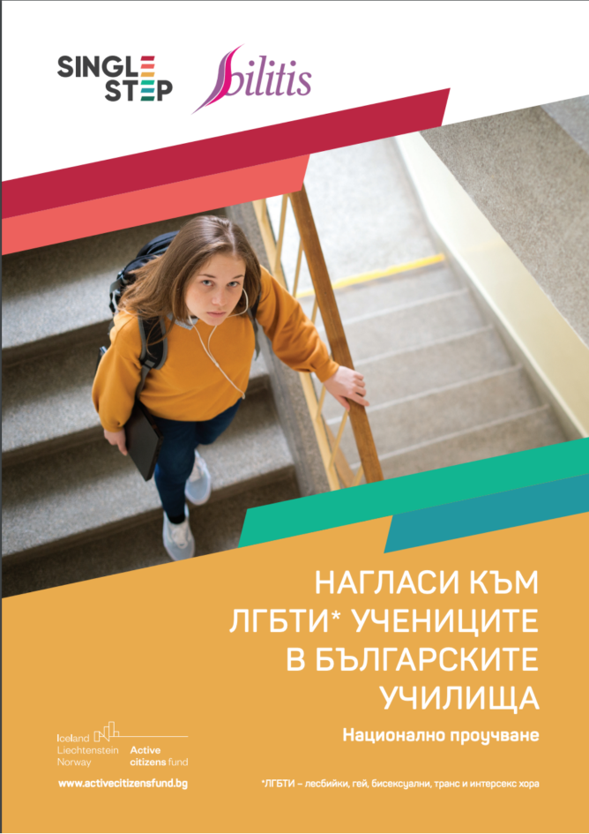
Schools and Universities
Teachers’ perspective
Not enough safe spaces and education. Close-minded parents and teachers.
Small recent improvements
Students’ perspective
Discrimination
Safe spaces and support
Universities
More accepting in some places but discrimination exists

Slide 9
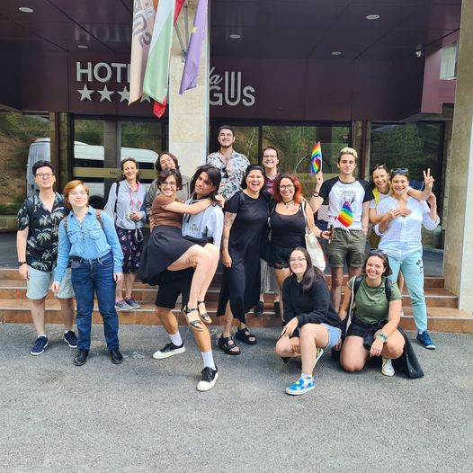
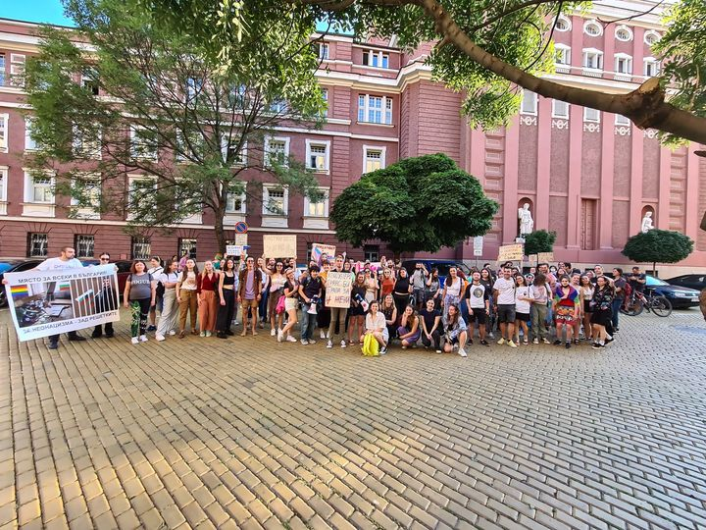
We are stronger than ever!
Rainbow Hub, Bilitis and Glass Foundations and Queer spaces
Strong community

Slide 10
Thank you for your support!

